Slide 1

Capstone Project - 2
YES BANK STOCK CLOSING PRICE PREDICTION
By Ghanshyam Singh Shakatawat

Slide 2

Contents
Problem Statement
Data Understanding
Data set loading
EDA
Feature Engineering
Model Implementation
Linear Regression
Lasso Regression
Ridge Regression
Model Explainability
Conclusion

Slide 3

Problem Statement
Yes Bank is a well-known bank in the Indian financial domain. Since 2018, it has been in the news because of the fraud case involving Rana Kapoor. Owing to this fact, it was interesting to see how that impacted the stock prices of the company and whether Time series models or any other predictive models can do justice to such situations. This dataset has monthly stock prices of the bank since its inception and includes closing, starting, highest, and lowest stock prices of every month. The main objective is to predict the stock's closing price of the month.

Slide 4
Data Understanding
You can see the data set has zero null values and zero duplicate values, the data set is having 185 rows and the 5 columns, we will try to find the prediction of the closing price by using the above data set and will check the prediction is accurate or not. So in the data set closing price will work as the dependent variable and other four columns will work as independent variable.

Slide 5
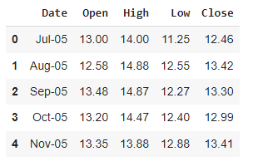
Data set loading
We have loaded data using panda’s read_csv function.

Slide 6
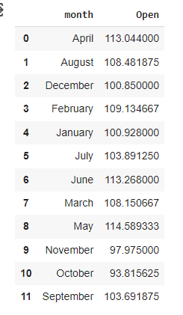
EDA
1. Stock Open mean price as on month

Slide 7
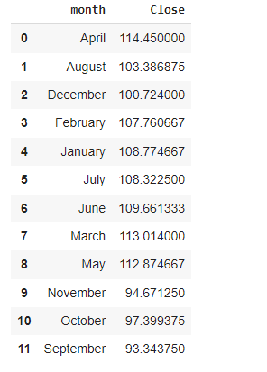
EDA
2. Stock Close mean price as on month

Slide 8
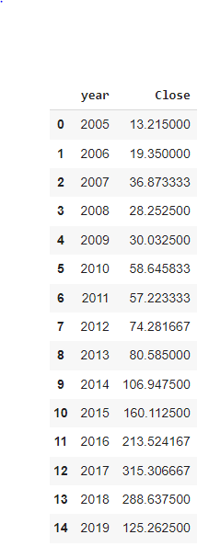
EDA
3. Stock Close mean price as on Year

Slide 9
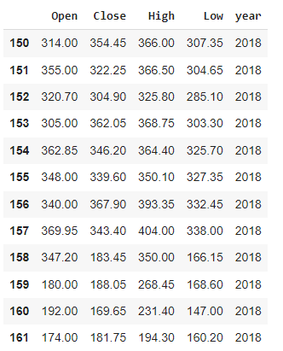
EDA
4. stock open, close, high and lower price as on year 2018

Slide 10
Model Implementation
Linear Regression
Lasso regression
Ridge regression

Slide 11
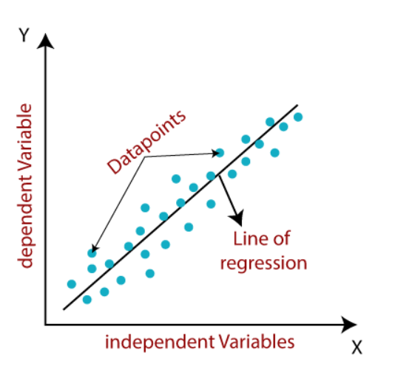
Linear Regression
Simple Linear Regression: If a single independent variable is used to predict the value of a numerical dependent variable, then such a Linear Regression algorithm is called Simple Linear Regression.
Multiple Linear regression*: If more than one independent variable is used to predict the value of a numerical dependent variable, then such a Linear Regression algorithm is called Multiple Linear Regression.

Slide 12
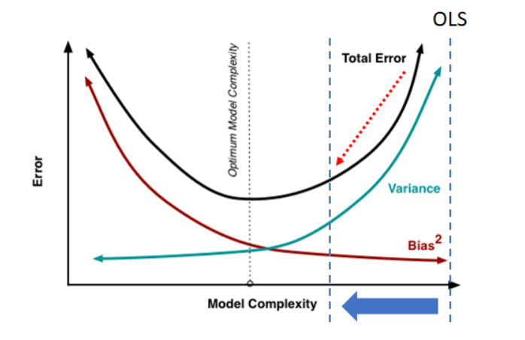
Ridge Regression
Ridge regression is a specialized technique used to analyze multiple regression data that is multicollinear in nature. It is a fundamental regularization technique, but it is not used very widely because of the complex science behind it. However, it is fairly easy to explore the science behind ridge regression in r if you have an overall idea of the concept of multiple regression. Regression stays the same, but in regularization, the way the model coefficients are determined is different.

Slide 13
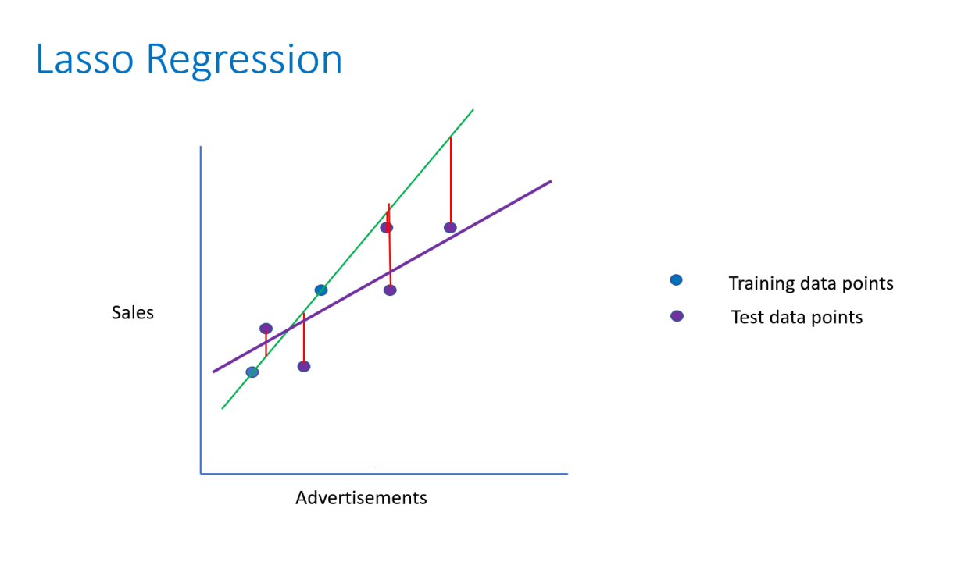
Lasso Regression
Lasso regression is also called Penalized regression method. This method is usually used in machine learning for the selection of the subset of variables. It provides greater prediction accuracy as compared to other regression models. Lasso Regularization helps to increase model interpretation.

Slide 14
Conclusion
We can see the minimum closing price of the stock was in the November month.
If we do analysis on the yearly basis, minimum closing price was in 2005
Which is 13.215 and after 2018 scam year it came to 22.10 during the 2020.
The data set is balanced no null value, missing value and duplicate value
In Univaraite analysis all the variables were positively skewed which is a
Regression problem data should be equally distributed.
In bivariate we can see variables are having a linear relation with each other.
We can see a huge fall in the price in the year 2018 when the fraud came to news.
We can observe the outliers in the box plot segment.
Data was positively skewed, and that's why we have done the log 10 transformation.
In the correlation heat map, we can see all variables are highly correlated to each other which is a problem in linear regression.
At last I use three models in those three models Ridge regression model shows the better value of R2 score, for this type of regression models higher the value of R2 shows, model is more efficient , used GridsearchCV in the last model .

